Slide 1
Pasqal workshop
Lecture 1: Neutral atoms quantum computing

Slide 2
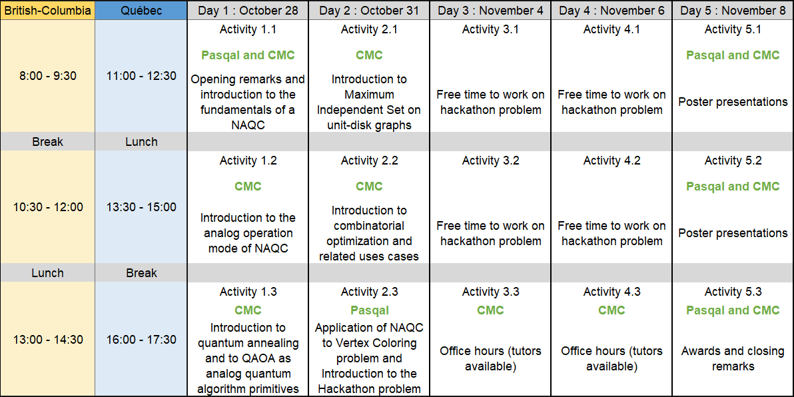
But first: logistics

Slide 3
But first: logistics
Relevant files are in the Teams channel “Hackathon General Info”.
You must read our Code of Conduct.
Please complete the survey during activity 5.1.
List of teams and its members by Wednesday, Oct 30th, 4pm!
Attendance of the tutorials is mandatory: do not miss more than one tutorial.
Hackathon: logistics and problem description will be explained during activity 2.3, on Thursday, Oct 31st.

Slide 4
Summary
What is Neutral Atom Quantum Computing?
Quantum processing:
Digital
Analog
Quantum computing applications
Applications beyond QC

Slide 5
Neutral atoms: basics
NAQC are generally based in Rubidium atoms.
Rydberg state:
in an atom with large principal number, the valence electron may behave hydrogen-like.
It will be very responsive to EM fields.

Slide 6
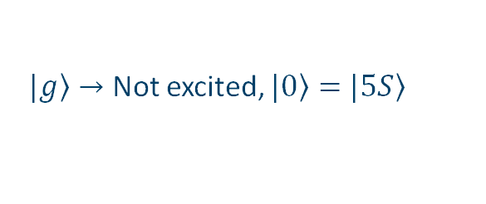
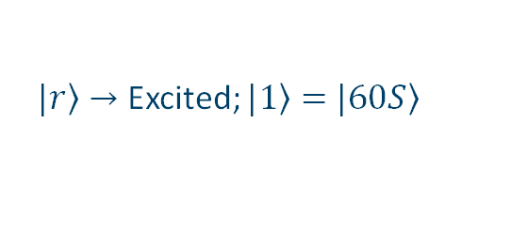
Neutral atoms: basics
NAQC are generally based in Rubidium.
The two-levels system in the RYDBERG BASIS:
Rydberg state
$|\left.r\right\rangle →$ Excited; $\left.|1\right\rangle =\left.|60S\right\rangle$
$|\left.g\right\rangle →$ Not excited, $\left.|0\right\rangle =\left.|5S\right\rangle$
Ground state

Slide 7
Neutral atoms arrays
Light is used to:
- Assemble and readout registers
- Perform quantum processing

Slide 8
Manipulating atoms
The atom-laser interaction is characterized by the
Rabi frequency Ω (its strength, proportional to the amplitude of the laser field),
the detuning δ (the difference between the qubit resonance and the field frequencies)
and their relative phase ϕ.

Slide 9
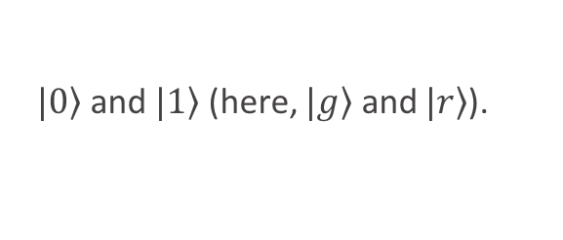
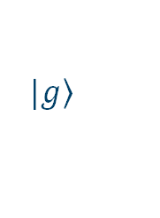
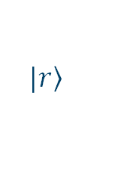
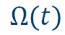

Manipulating atoms
We can manipulate states by shining the laser close to the transition between
$\left.|0\right\rangle$ and $\left.|1\right\rangle$ (here, $\left.|g\right\rangle$ and $\left.|r\right\rangle$).
$$|\left.r\right\rangle$$
$$δ\left(t\right)$$
Detuning
$$Ω\left(t\right)$$
Rabi frequency
$$|\left.g\right\rangle$$

Slide 10

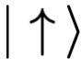

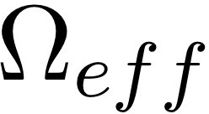


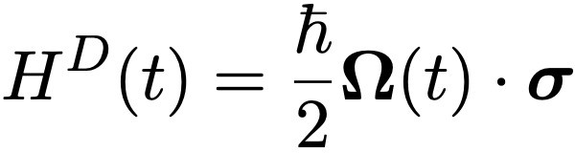
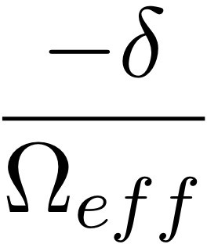
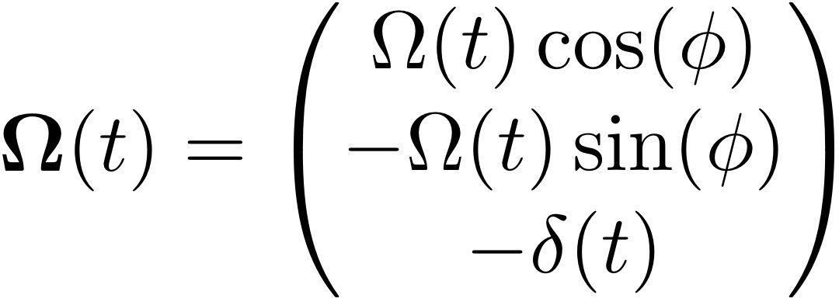



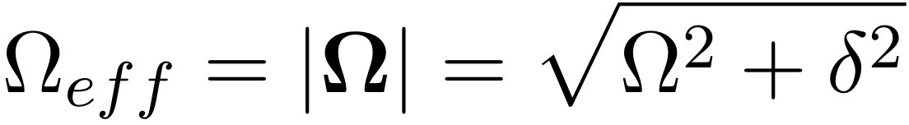
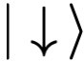
Global laser pulses
Driving Hamiltonian
“Angular velocity” vector
Effective Rabi frequency
10
October 29, 2024 | Lecture 1: Neutral atoms quantum computing

Slide 11
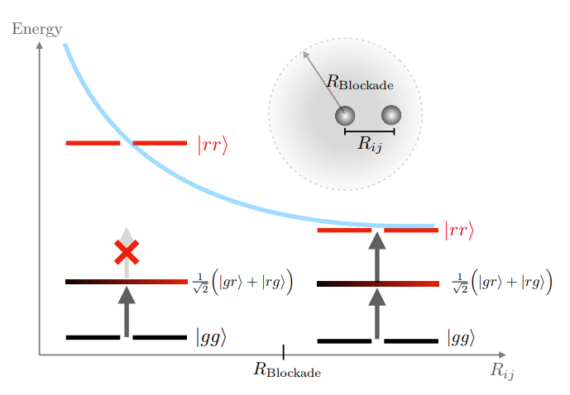
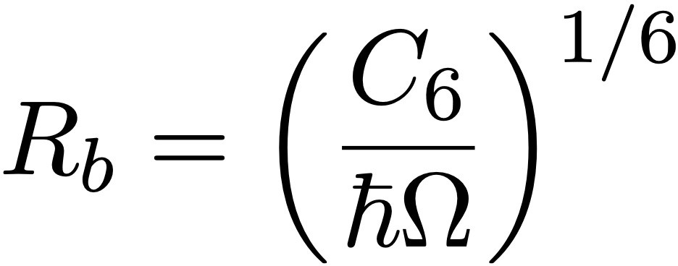
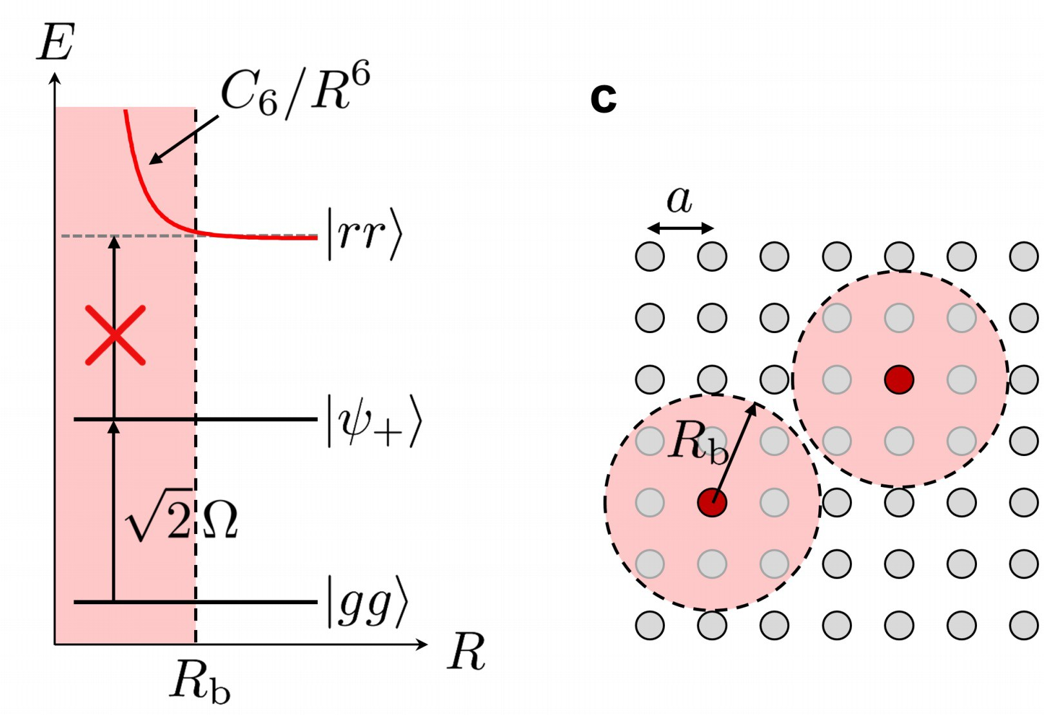
Rydberg blockade effect
Rydberg radius
11

Slide 12

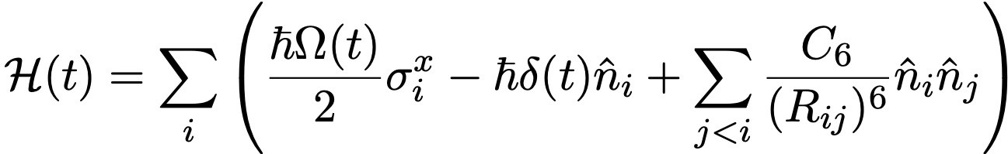
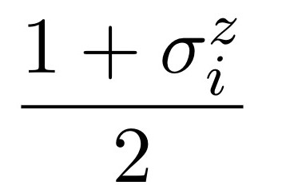
Rydberg blockade effect
Comes from interaction term in our Hamiltonian – will be discussed later
Rydberg radius
12

Slide 13
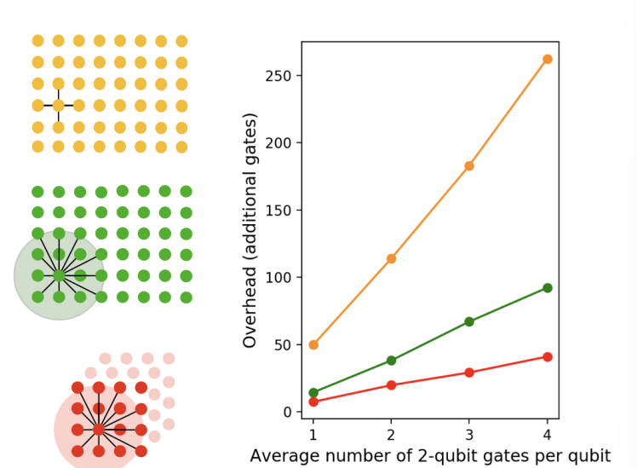
Connectivity advantage
Yellow: nearest neighbor interaction (superconducting - transmon)
Green: 2D neutral atoms
Red: 3D neutral atoms
Figure from https://arxiv.org/pdf/2006.12326

Slide 14
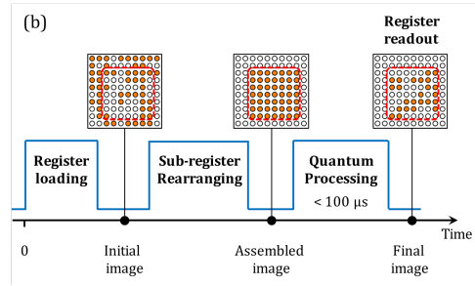
The full process
Let’s discuss first what happens
Before quantum processing: Register loading and Sub-register rearranging
After quantum processing: readout

Slide 15
Register loading
First: system of lasers prepare cold atoms (laser cooling + trapping)
Second: system isolate those atoms (each tweezer contains one atom, or no atoms)
1 atom trapped
per tweezer

Slide 16
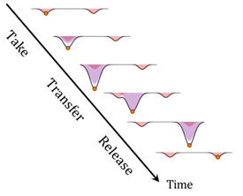
Sub-register loading
Atoms are rearranged in a sub-register by moving them around

Slide 17
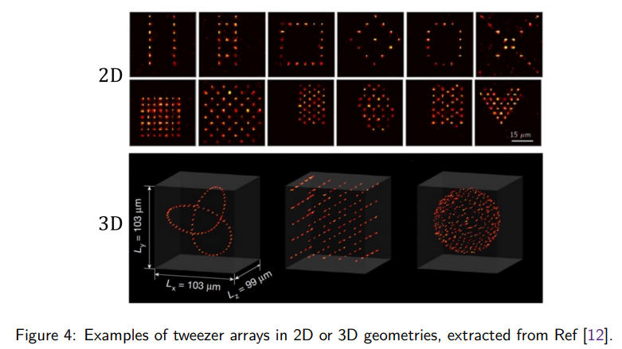
Sub-register loading
Atoms are rearranged in a sub-register by moving them around

Slide 18



















































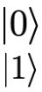





Register readout
Done via fluorescence image, in a way that
qubit |0> appears bright
qubit |1> appears dark.
This process needs to be repeated several times to build quantum statistics.
Fluorescence image

Slide 19
Neutral atoms: advantages
Low error rate: a "natural" qubit rather than a qubit that might contain fabrication errors
Large connectivity
Reprogrammability of the atomic register
Native implementation for multi-gates
Digital and analog modes

Slide 20
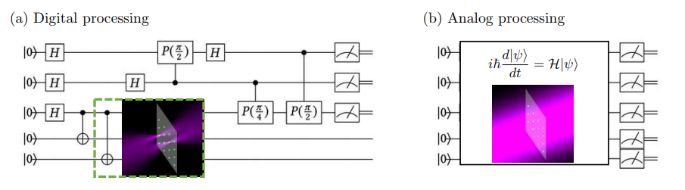
Quantum processing
NAQC can be analog or digital.
Local operations
Continuous and global

Slide 21
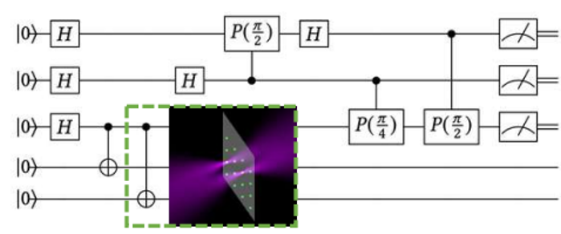
Quantum processing - DIGITAL
Discrete operations on qubits.
The two-levels are in the RAMAN BASIS:
- ground
- hyperfine
No Rydberg blockade between these states!

Slide 22
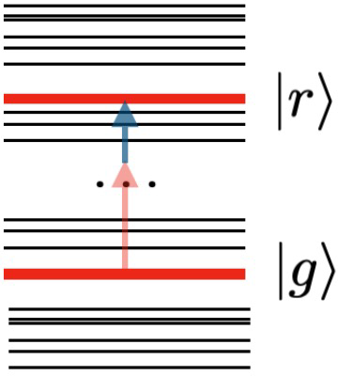

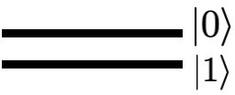

Quantum processing - DIGITAL
Discrete operations on qubits.
The two-levels are in the RAMAN BASIS:
- ground
- hyperfine
No Rydberg blockade between these states!
Intermediate Rydberg state
$$|\left.r\right\rangle$$
…
Basis states
Raman channel

Slide 23
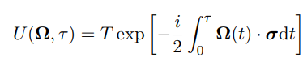
Quantum processing - DIGITAL
Any single-qubit gate can be implemented with laser pulses.
A pulse of duration τ performs the time evolution:

Slide 24
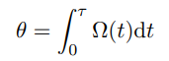
Quantum processing - DIGITAL
On resonance (δ = 0), the qubit oscillates in time between the states |0> and |1>: Rabi oscillations.
This pulse performs a rotation by
around the equator.

Slide 25
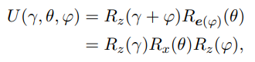
Quantum processing - DIGITAL
We can generate any unitary (single qubit) gate with similar rotations of resonant pulses:

Slide 26
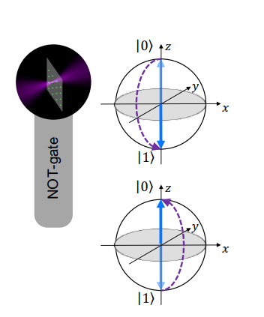
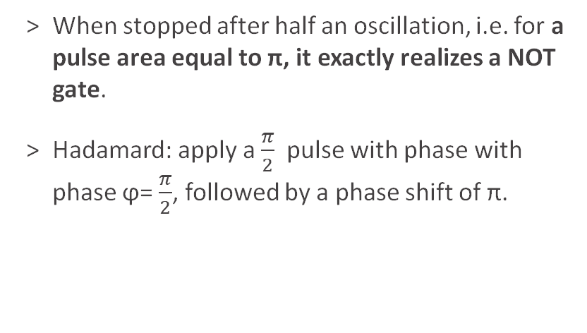
Quantum processing - DIGITAL
When stopped after half an oscillation, i.e. for a pulse area equal to π, it exactly realizes a NOT gate.
Hadamard: apply a $\frac{π}{2}$ pulse with phase with phase ϕ= $\frac{π}{2}$, followed by a phase shift of π.

Slide 27
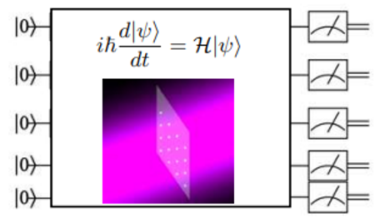
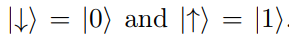
Quantum processing - Analog
Continuous and global time evolution.
Rydberg atoms have strong dipole-dipole interaction, motivating the mapping to spin Hamiltonians.

Slide 28
Quantum processing - Analog
Ising model: when the |↓> state is one of the ground states and the |↑>
a Rydberg state
Magnetic field interactions:
B⊥ ∝ Ω(t)
B|| ∝ −δ(t).
R⁻⁶ interaction among spins: Van der Waals

Slide 29
Quantum processing - Analog
Ising model can describe:
Low temperature magnets
Computational problems (discussed later)

Slide 30
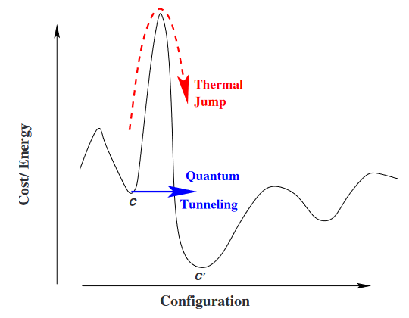
Suitable for
Quantum annealing
Quantum Approximate Optimization Algorithm

Slide 31
Applications of NAQC
1 - Quantum simulations
Condensed matter and chemistry: problems can often be mapped to the dynamics of Ising model.
Hubbard model
Non equilibrium spin chains
Spin liquids
High energy and Nuclear physics: lattice gauge theory.

Slide 32
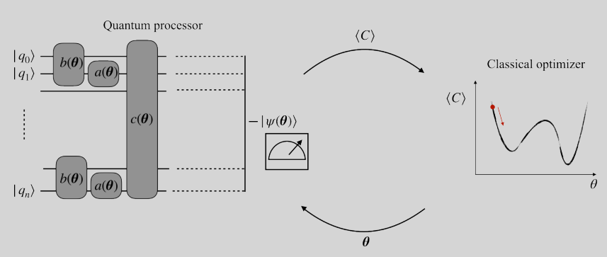
Applications of NAQC
2 – Computational tasks in NISQ era:
Variational algorithms

Slide 33
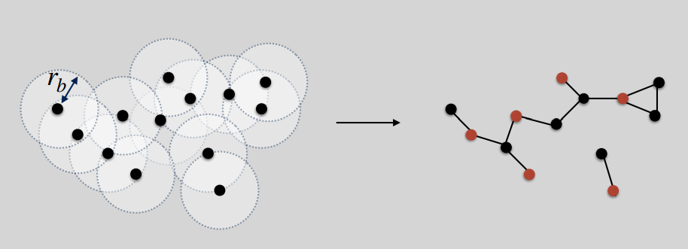
Applications of NAQC
QC tasks in NISQ era:
Graph combinatorial optimization
Example application: Maximum independent set (MIS) graph problem
We can map atoms within the Rydberg blockade radius as nodes in a graph with connecting vertices

Slide 34
Applications of NAQC
Graph theory problem | Application example
Maximum independent set | Traffic optimization Antenna placement Channel allocation Windmill optimization
Maximum clique | Portfolio optimization Biological and social networks
Minimum vertex cover | Fraud detection Immunization strategies
Graph coloring | Task scheduling Route optimization

Slide 35
Applications of NAQC
QC tasks in NISQ era:
Machine learning
QEK (quantum evolution kernel)
Quantum Extremal Learning
Others

Slide 36
Going beyond
Promising for fault-tolerance: many proposals for highly efficient error correcting codes taking advantage of connectivity
Multicore architecture: challenging because requires coherent interfaces between atomic qubits and single photons
Quantum memory for photonic qubits, using electromagnetically-induced transparency

Slide 37
Pulser
Open-source library
Python-based
Allows for pulse level control in neutral atom platforms
Suitable for digital and analog modes

Slide 38

Pulser

Slide 39
Pulser – core components
Register: group of qubits and their positions.
Channels: lasers, acting globally or locally to manipulate the atoms.
Device: physical or virtual.
Sequence: series of Pulses (and other instructions) that are sequentially allocated to channels.
Waveforms: amplitude and detuning throughout the pulse.

Slide 40
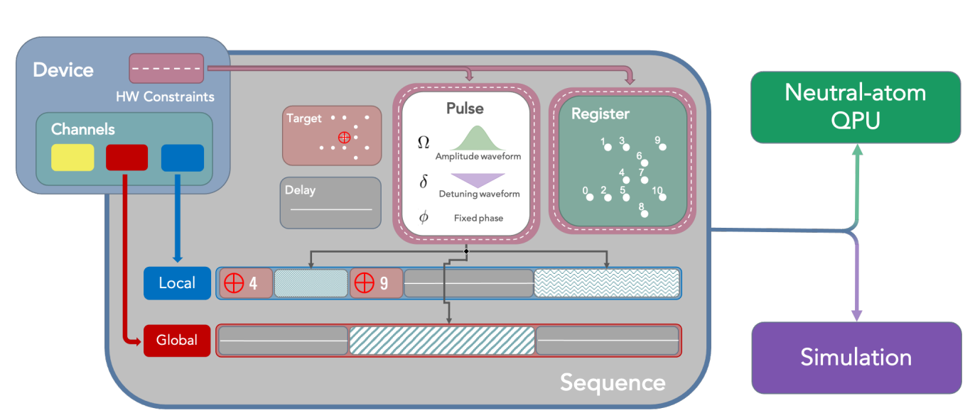
Pulser

Slide 41
Pulser
Let’s code!

